Slide 1

Software Design and architecture (SE322) gg
Week 11
Said Nabi
said.nabi@giki.edu.pk
Faculty of Computer Science and engineering
Gik Institute Topi, Swabi

Slide 2
List of Topics
Code Smells, Anti Patterns, 4+1 View Model, MVC

Slide 3
Divergent Change:
The Divergent Change code smell appears when a single class needs to be modified in multiple ways for different reasons.
This often happens when a class takes on too many responsibilities, similar to the Large Class problem. Such a design lacks proper separation of concerns, making the code harder to maintain and more prone to errors when updates are made.
To fix this, each class should have a clear, single purpose, limiting the number of reasons it needs to change. If a class frequently requires different types of modifications, its responsibilities should be divided into smaller, more focused classes.
By applying separation of concerns, both the Large Class and Divergent Change issues can be effectively resolved, resulting in cleaner, more maintainable code.

Slide 4
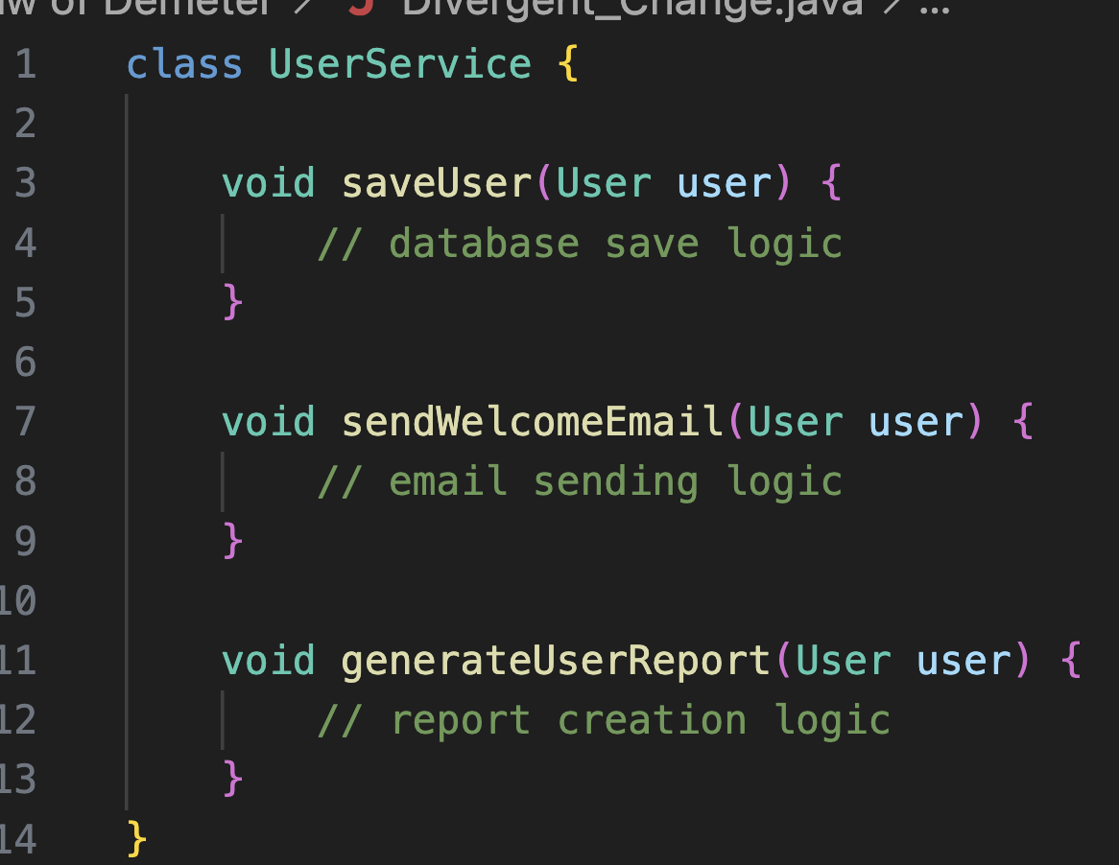
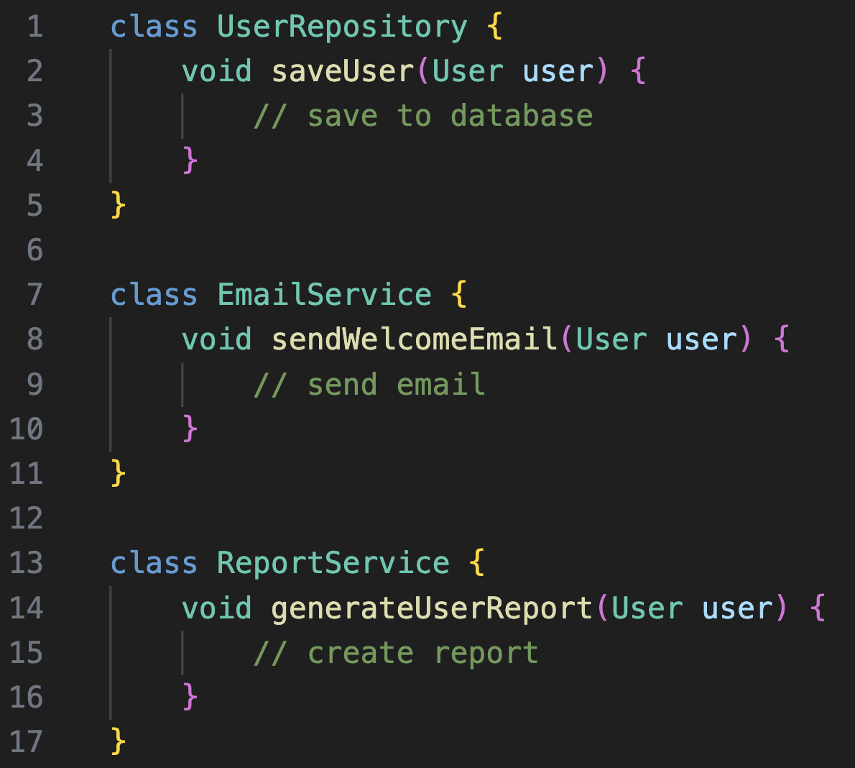
Example:

Slide 5
Shotgun Surgery:
The Shotgun Surgery code smell occurs when a single change requires modifying multiple classes or methods across the codebase.
Ideally, changes should be localized, but this issue arises from poor organization and scattered responsibilities, leading to the risk of missing updates or introducing errors.
To fix this, related methods should be grouped into fewer cohesive classes.
However, merging too many responsibilities can lead to a Large Class problem. Shotgun surgery signals the need for better modularity and cohesion in the code structure.

Slide 6
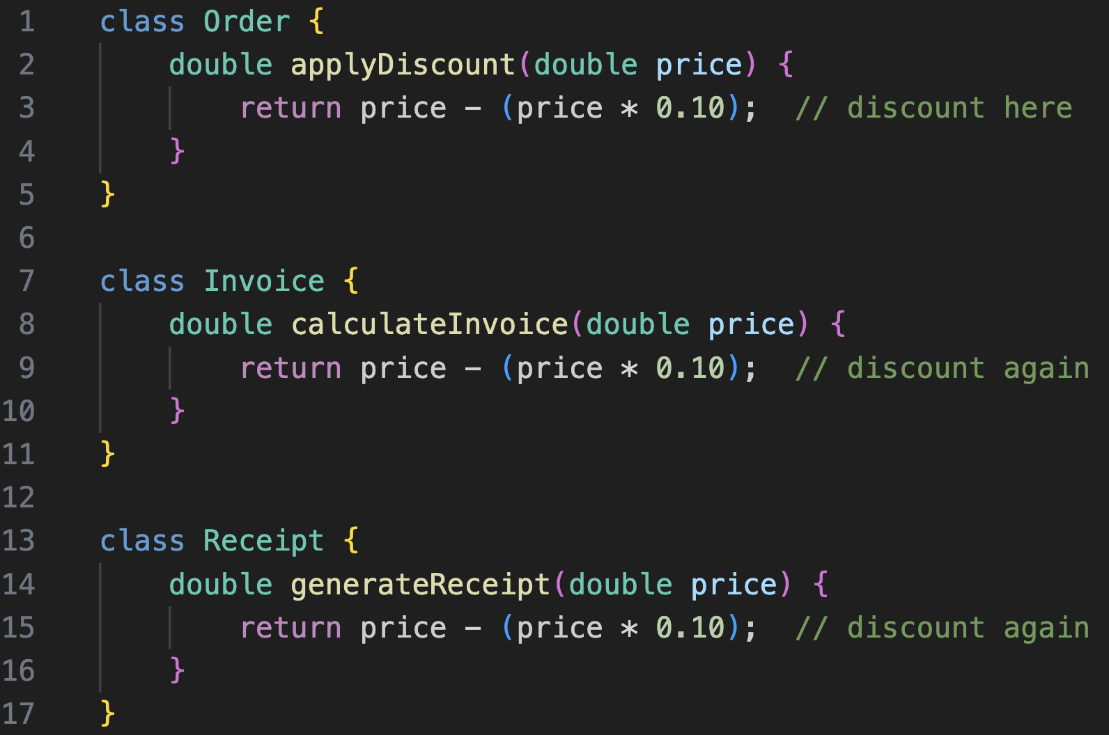
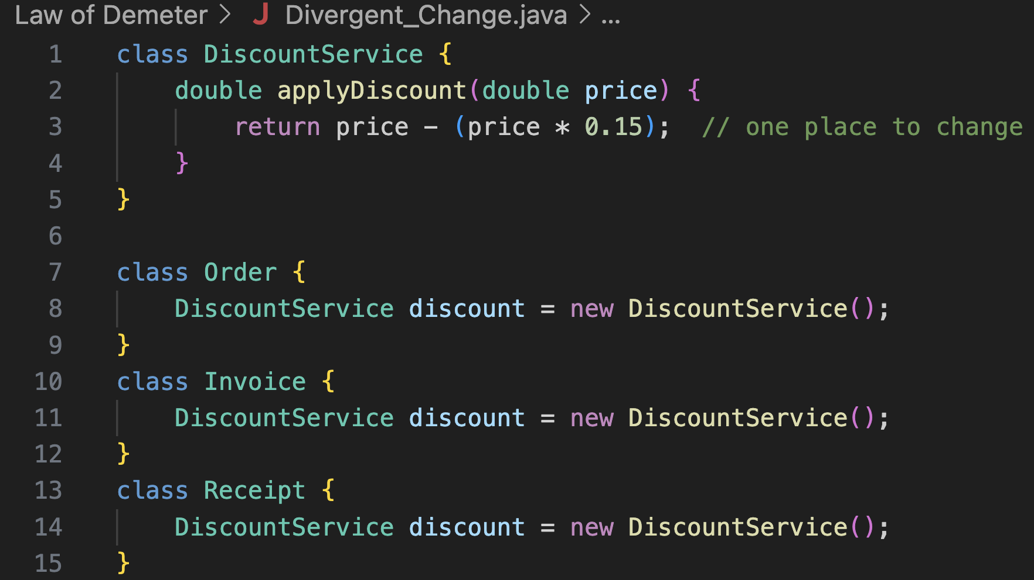
Example:

Slide 7
Feature Envy:
The Feature Envy code smell appears when a method seems overly interested in the data or behavior of another class rather than its own.
This usually happens when one class frequently accesses or manipulates the internal details of another, suggesting that the functionality is misplaced.
If two classes or methods constantly interact and depend on each other’s data, it’s often a sign that they should be reorganized or merged so that the behavior resides where it logically belongs, improving encapsulation

Slide 8
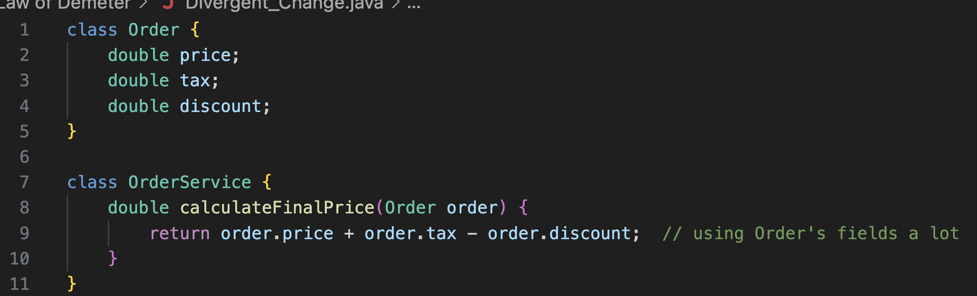
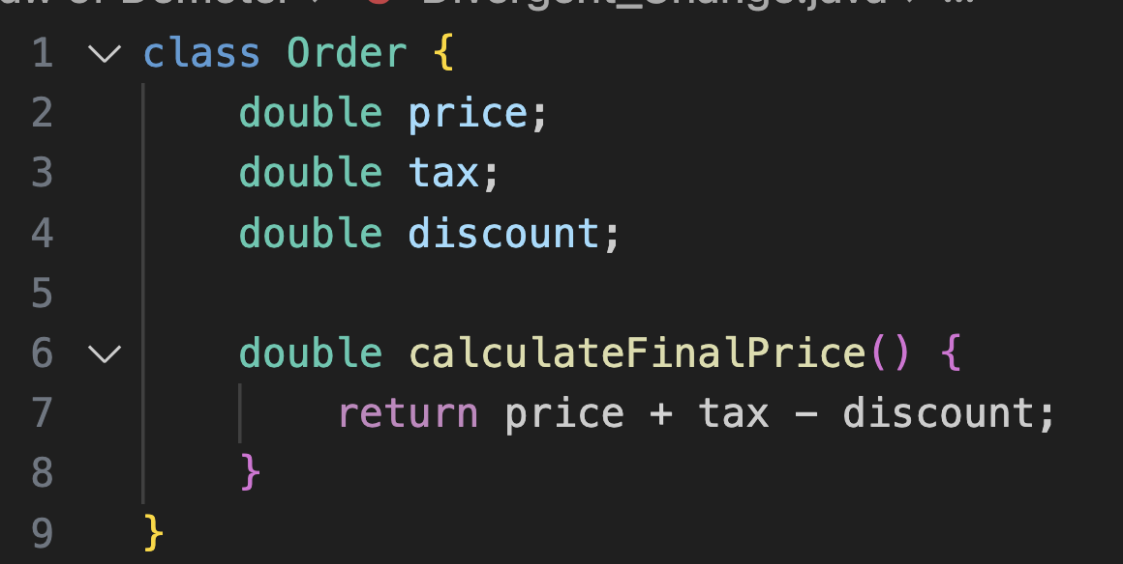
Example:

Slide 9
Inappropriate Intimacy:
The Inappropriate Intimacy code smell occurs when two classes are overly dependent on each other, frequently communicating back and forth. This tight two-way coupling makes the system harder to maintain and understand.
For example, if methods in one class frequently call methods in another—and vice versa—it creates a cyclic dependency.
The solution is to refactor shared behaviors into a separate class that both can use, reducing direct interaction and promoting looser coupling.
While some cycles may be unavoidable, simplifying relationships between classes generally leads to cleaner, more modular, and easier-to-maintain code.

Slide 10
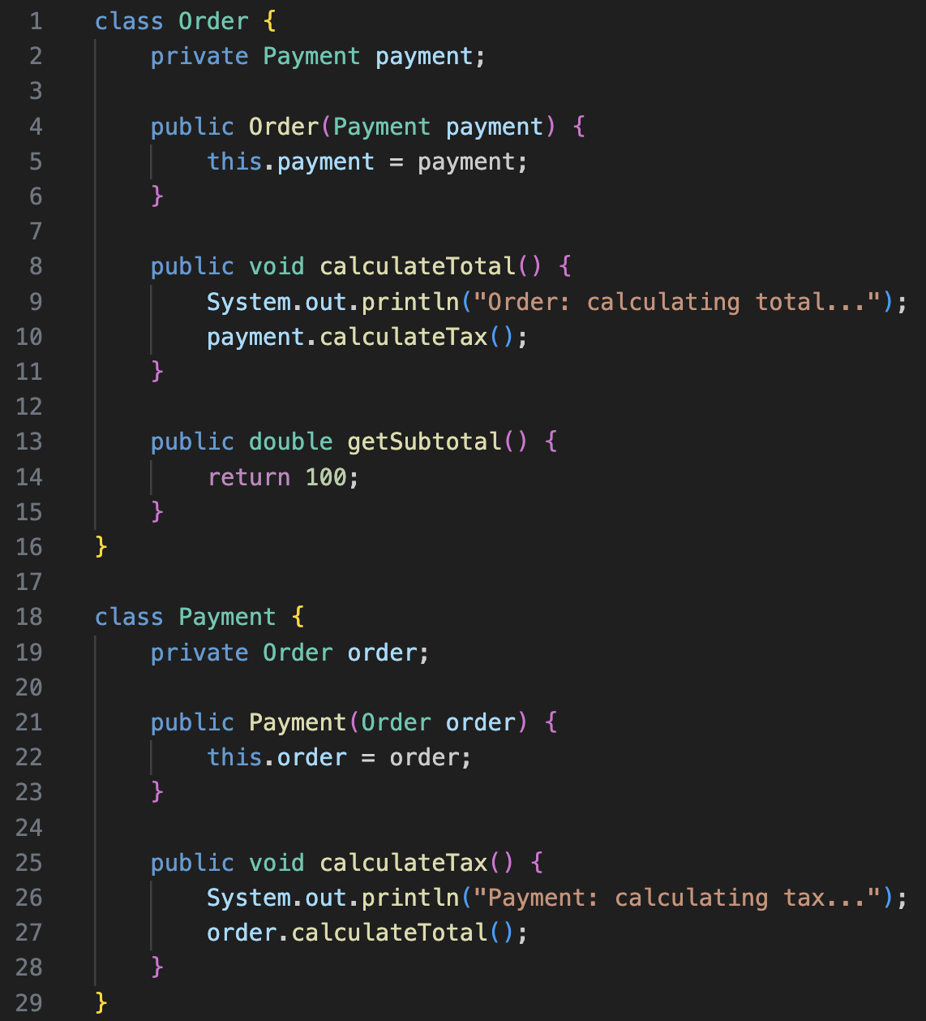
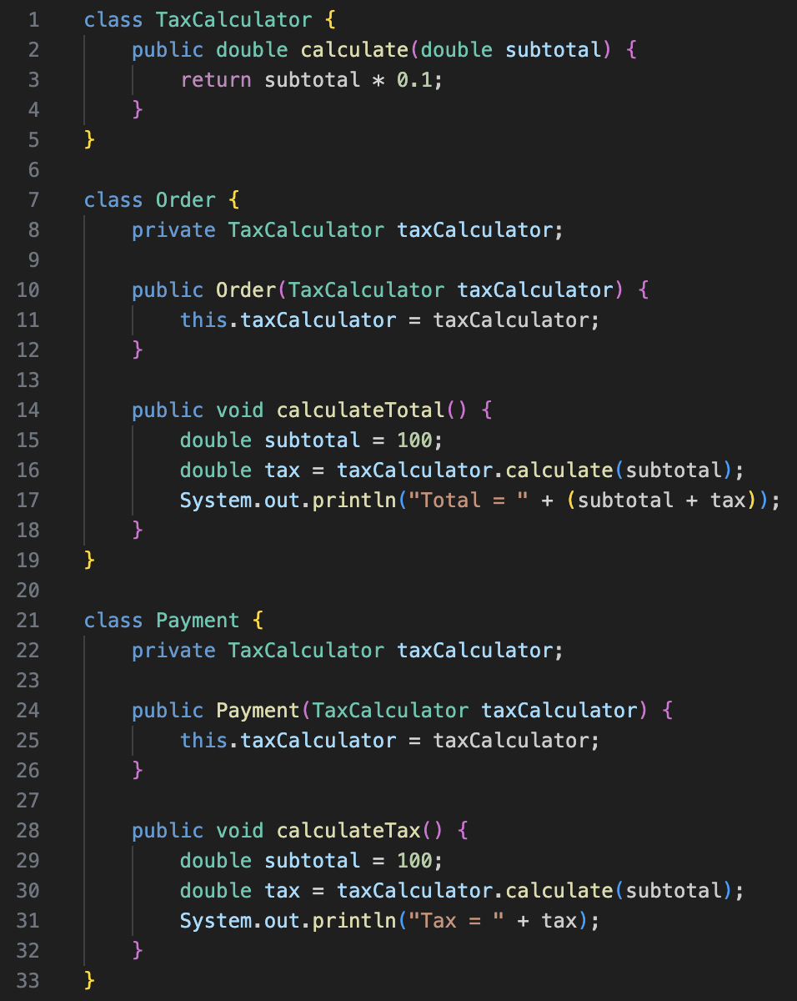
Example:

Slide 11
Message Chain:
The Message Chains code smell occurs when a piece of code makes a long series of method calls, such as objectA.getB().getC().getD(). This creates rigidity and complexity, making the code harder to understand, maintain, and test independently.
Such chains often violate the Law of Demeter, which advises against “reaching through” multiple objects to access methods or data.
Long message chains also make the design fragile, since any change in the chain’s structure or dependencies can easily break the code.
However, short and controlled chains can be acceptable if the returned objects and method calls still respect the Law of Demeter.
In general, reducing message chains helps improve encapsulation, flexibility, and code resilience.

Slide 12
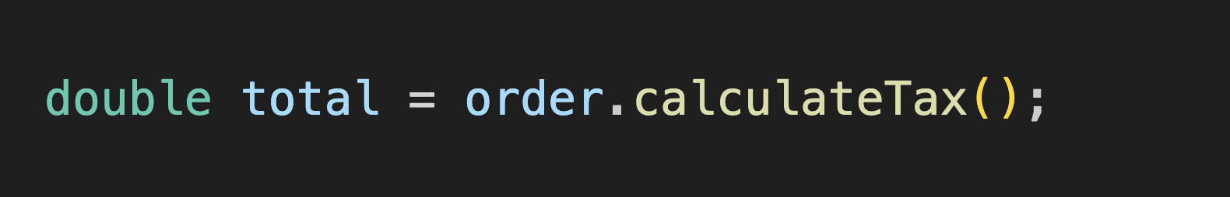
Example:

Slide 13
Primitive Obsession:
The Primitive Obsession code smell occurs when a program overuses built-in data types like int, float, or String instead of creating custom classes to represent meaningful concepts.
While primitives are necessary at low levels of code, relying on them too heavily at higher levels indicates poor abstraction and a non-object-oriented design. Historically, older programs stored everything as strings or arrays, but modern languages allow developers to define specific types for clarity and structure.
When too many primitives are used, important abstractions become hidden within code details, making the system harder to understand and maintain.
Detecting primitive obsession is often a sign that the program needs new classes or objects to model real-world concepts more effectively.

Slide 14
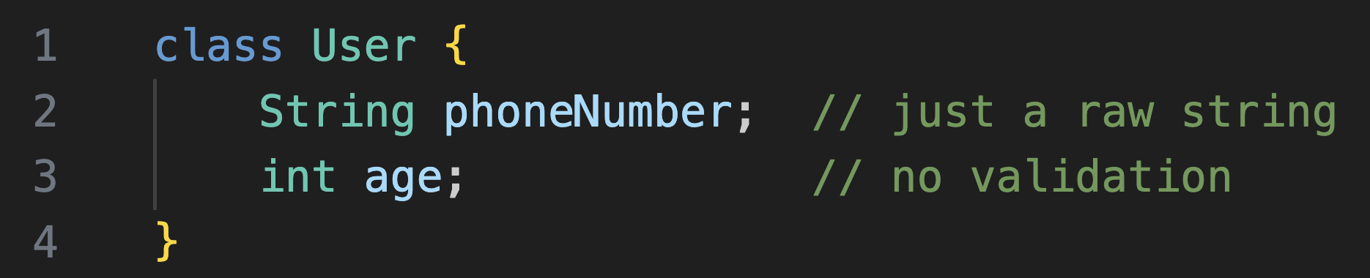
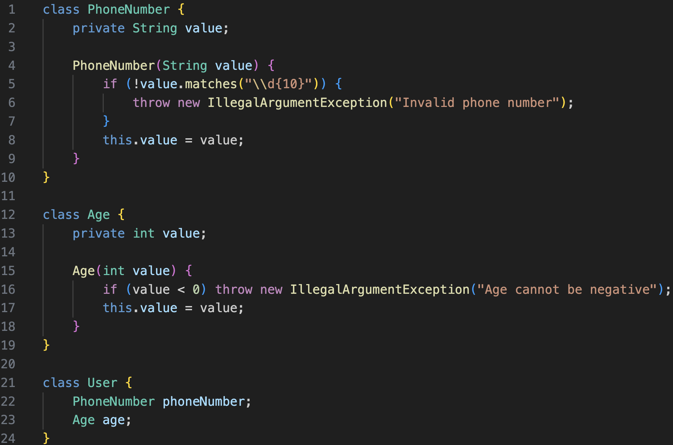
Example:

Slide 15
Switch Statement:
The Switch Statement code smell appears when multiple switch or conditional statements are scattered throughout the code.
This makes maintenance difficult because any change to one switch often requires updating all similar statements elsewhere.
While some conditional logic is necessary, frequent use of switches—especially those checking type codes or object types—suggests a design flaw.
A better solution is to replace repetitive switch statements with polymorphism, where each class handles its own behavior.
This approach makes the code easier to extend, cleaner to maintain, and more aligned with object-oriented principles.

Slide 16
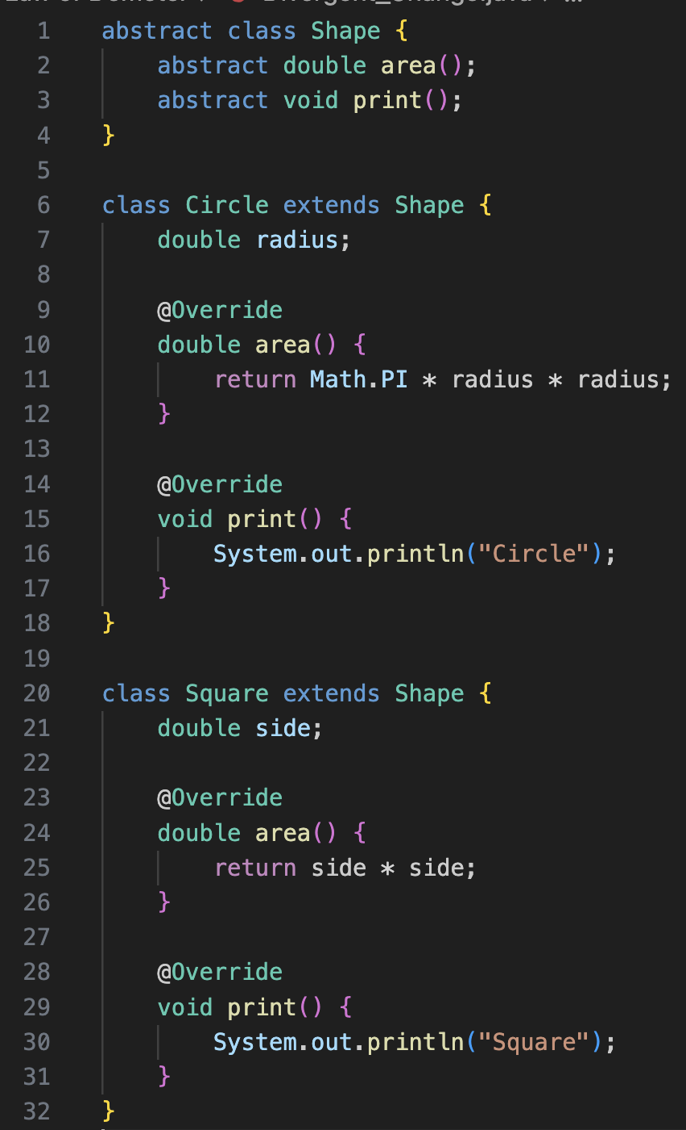
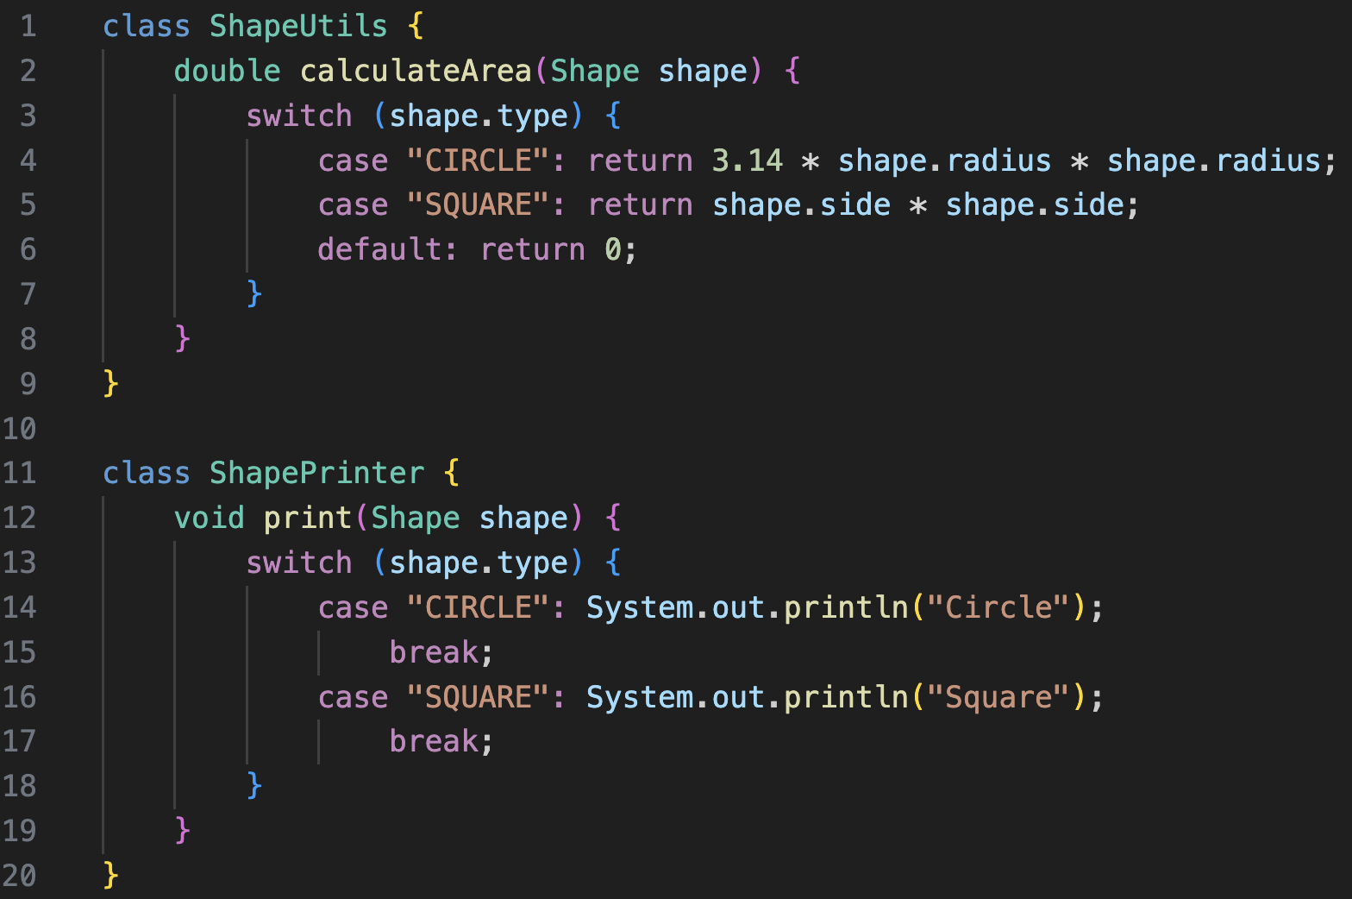
Example:

Slide 17
Speculative Generality:
The Speculative Generality code smell occurs when developers create superclasses, interfaces, or extra features that aren’t currently needed but are added in case they might be useful in the future.
This leads to over-engineered and unnecessarily complex code. In Agile development, the preferred approach is Just-in-Time Design—building only what’s required for the current iteration rather than preparing for uncertain future needs.
Since software requirements can change frequently, spending time on unused abstractions often results in wasted effort.
If generalization becomes necessary later, it’s better to implement it when it’s truly needed, even if it takes slightly more time, ensuring the system remains simple, focused, and adaptable.

Slide 18
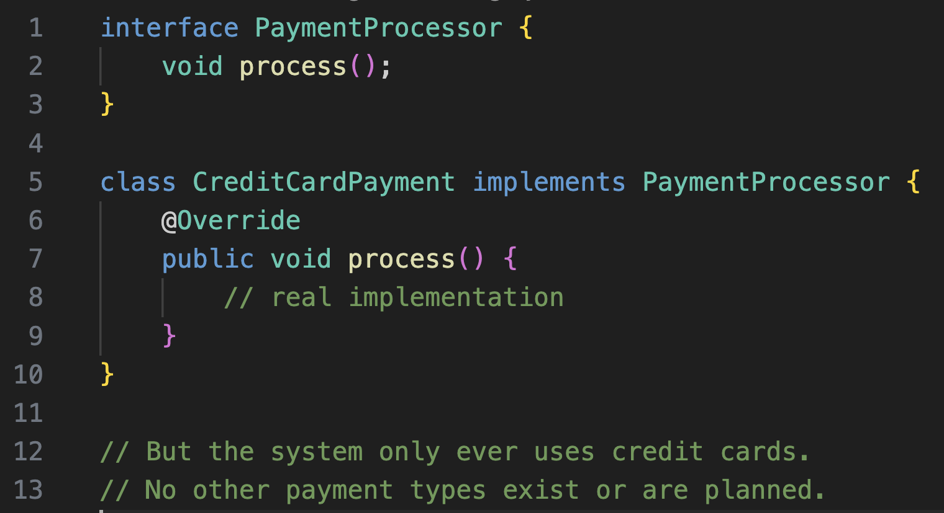
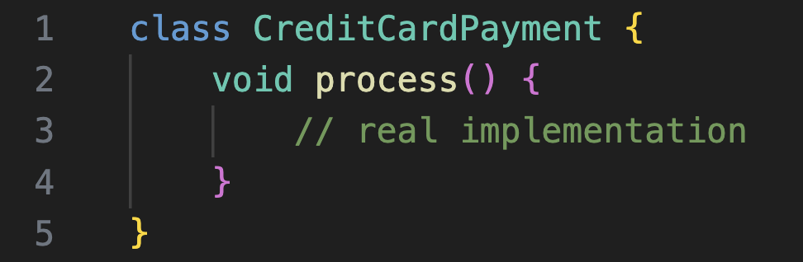
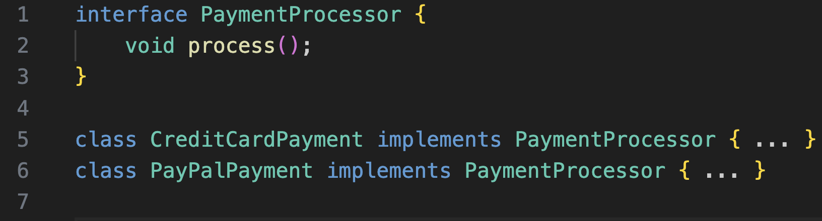
Example:

Slide 19
Refused Request:
The Refused Request code smell occurs when a subclass inherits methods or properties it doesn’t need or use.
This often indicates that the subclass is not a proper fit for its superclass. In such cases, the subclass might be better designed as a stand-alone class, or the unnecessary behavior should be removed from the superclass.
If only a few subclasses require certain methods, those behaviors should be defined within those specific subclasses instead.
Regularly reviewing code for such design flaws helps maintain reusability, flexibility, and maintainability.
Identifying and correcting code smells like this ensures cleaner, more efficient designs and stronger adherence to object-oriented principles.

Slide 20
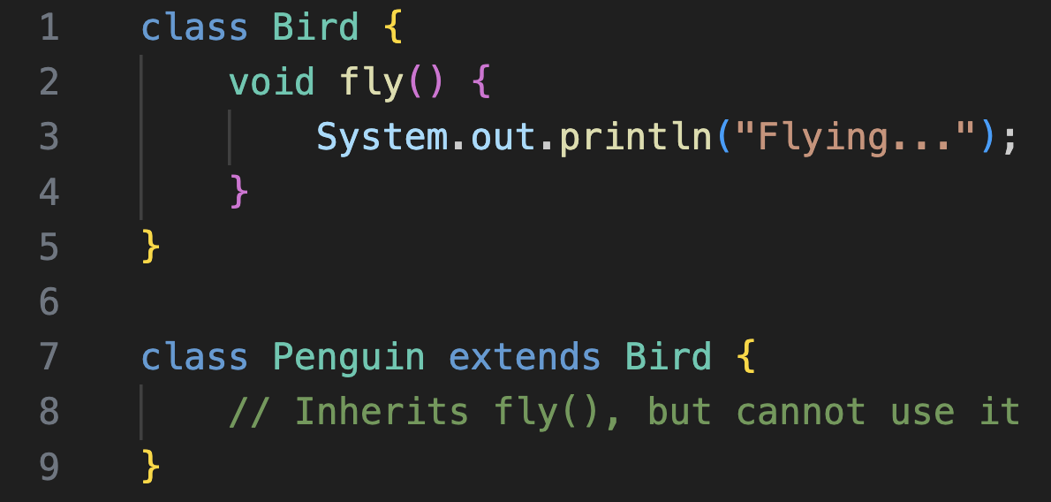
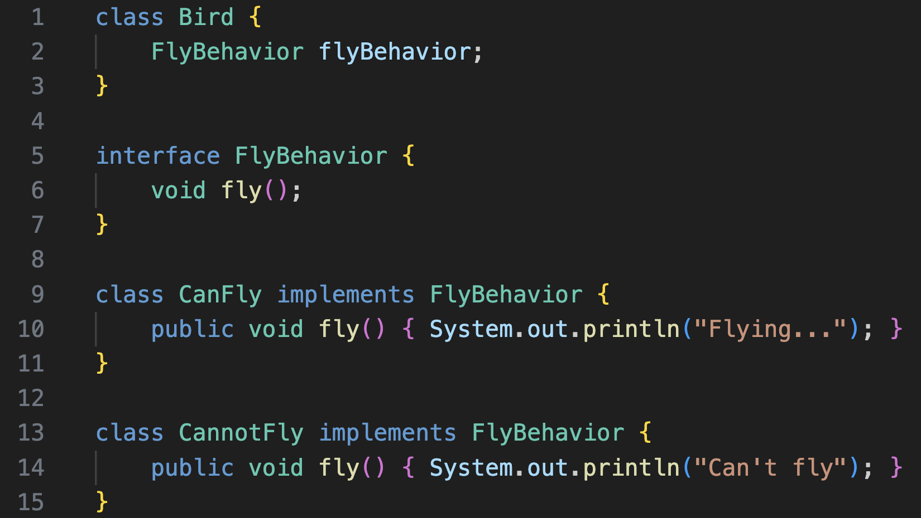
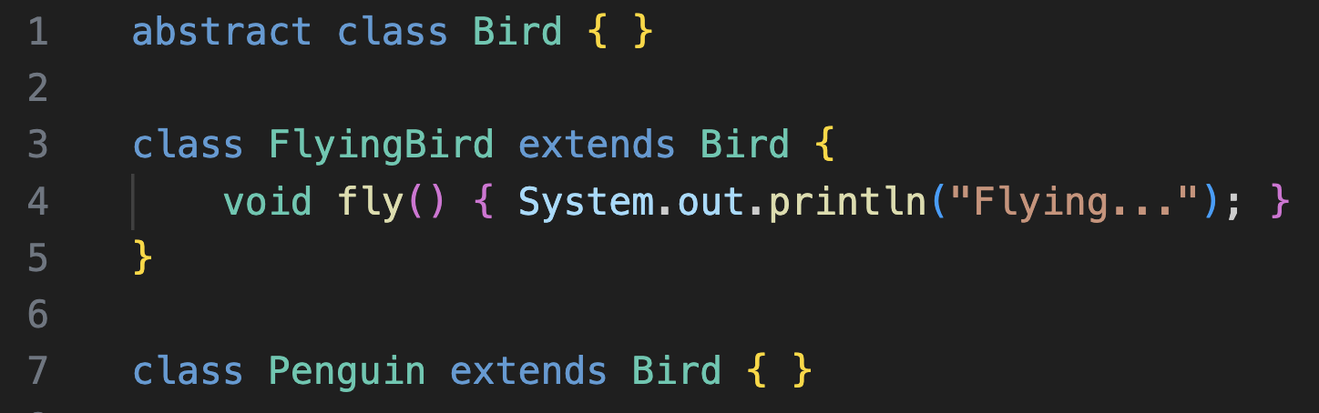
Example:

Slide 21
Software Architecture
Up to now, we’ve built a strong foundation in Object-Oriented Design (OOD) principles and design patterns—this foundation naturally prepares us for understanding software architecture.
Use Unified Modelling Language (UML) to document architectural design.
Explore various software architectural styles and patterns, understanding their strengths, weaknesses, and appropriate use cases.
Learn how to analyze and evaluate architectures based on quality attributes such as performance, scalability, maintainability, flexibility, and security.
Examine how software architecture is influenced by real-world constraints: implementation languages, deployment environments, team organization, business goals, development processes, product-line opportunities, and the overall intent behind the software system.

Slide 22

Software Architecture
Software architecture is the overall design and structure of a software system. It defines the system’s main components, their roles, and how they interact.
When designing it, architects consider the system’s purpose, users, key quality attributes, and operating environment.
A clear architecture provides a strong foundation for development, helping developers work efficiently, avoid conflicts, and reduce duplication or unnecessary work—especially in large systems.

Slide 23
Why Software Architecture
Software architecture improves productivity, evolution, and quality.
A clear structure helps teams coordinate work and address issues efficiently.
It also makes software easier to change, maintain, reuse, and adapt by applying solid design principles that consider all stakeholder needs.
When designing software architecture, architects must consider all stakeholders — the people who use, manage, or benefit from the system
— since their needs and interests shape how the system is built.
Software architecture typically have the following stakeholders. Each will have their own perspective.

Slide 24
Stakeholders
Stakeholder | Description
Software developers | Software architecture helps developers create and evolve software by providing strong direction and organization on what needs to be done.
Project Managers | Software architecture provides useful information to project managers to help them identify possible risks and to manage the project successfully. Software architecture helps project managers to understand task dependencies and impacts of change and to coordinate work assignments.
Clients | Clients make important decisions about the system, like its funding. Software architecture establishes a basis for communication with clients, so they understand what they are paying for and that their needs are met.
End users | Users may not care how the software is actually designed, but they do care that it “works well” for them.
Multiple perspectives are needed to fully understand and develop a software system.
One key perspective is functionality, which defines what the system does to meet the client’s requirements and achieve its intended purpose.

Slide 25
Kruchten’s 4+1 View Model
Software architecture can be understood through multiple perspectives, captured in Philippe Kruchten’s 4+1 View Model:
Logical View – Focuses on functional requirements, objects, and their interactions. UML class diagrams illustrate system classes, attributes, and behaviours.
Process View – Focuses on non-functional requirements like performance and availability, showing how objects interact through processes. UML activity and sequence diagrams are useful here.
Development View – Focuses on hierarchical structure, programming languages, libraries, tools, and project management considerations.
Physical View – Focuses on deployment of software components to hardware nodes. UML deployment diagrams represent this view.
Scenarios – Connect the four views by outlining user tasks and interactions, providing a complete picture of the system.
These views together help developers understand complex systems from multiple perspectives, improving design, flexibility, and maintainability.

Slide 26
Logical View
Represents the core business concepts and how they relate, helping both architects and developers understand the system’s domain clearly.
Breaks the system into logical modules (e.g., Users, Orders, Payments) so responsibilities are clearly separated.
Helps identify domain boundaries, shared data, and potential reuse opportunities early in design.
Ensures that business rules and workflows are captured accurately before worrying about technology or deployment.
Supports communication with non-technical stakeholders because it describes what the system does in clear, conceptual terms.
Encourages stable abstractions that make later changes safer and easier.

Slide 27
Process View
Shows how the system behaves when it is running, especially under load or when multiple actions happen at once.
Reveals which components need to run in parallel, which ones communicate frequently, and which ones run synchronously or asynchronously.
Highlights threads, processes, queues, and communication patterns, ensuring the architecture can meet performance and availability goals.
Helps detect bottlenecks early by modeling heavy workflows like payments, notifications, or real-time updates.
Ensures fault-tolerance by showing how the system should react to delays, failures, or spikes in activity.

Slide 28
Development View
Focuses on how the codebase is structured for humans, not machines—making the system easier to build, test, and maintain.
Defines layers, modules, and internal interfaces so developers know where code belongs and how components depend on each other.
Makes teamwork easier by providing clear ownership boundaries—for example, separate folders or repositories for different features.
Encourages reuse by identifying shared libraries, utilities, and common frameworks.
Helps manage complexity by organizing the project into meaningful units that can evolve independently.

Slide 29
Focuses on the real-world arrangement of the system across servers, machines, networks, and cloud environments.
Shows how software components are hosted—whether on virtual machines, containers, mobile devices, or edge hardware.
Helps evaluate system reliability by modeling redundancy, load balancers, failover nodes, and backup systems.
Reveals communication paths, such as API calls across servers or databases replicated across regions.
Ensures constraints like bandwidth, latency, security zones, and hardware limitations are considered.
Supports planning for scaling, deployments, and DevOps workflows.
Physical View

Slide 30
Provide end-to-end examples of how real users interact with the system, validating that all architectural views align.
Help detect missing components, unclear responsibilities, or incorrect assumptions before development begins.
Illustrate how the architecture handles normal flows (e.g., login, checkout) and exception flows (e.g., failed payment, network timeout).
Act as architectural test cases: if a view cannot support a scenario, the architecture must be refined.
Improve communication with stakeholders by showing how the system supports their actual tasks.
Tie the logical, process, development, and physical views into a single coherent story.
+1 Scenario

Slide 31
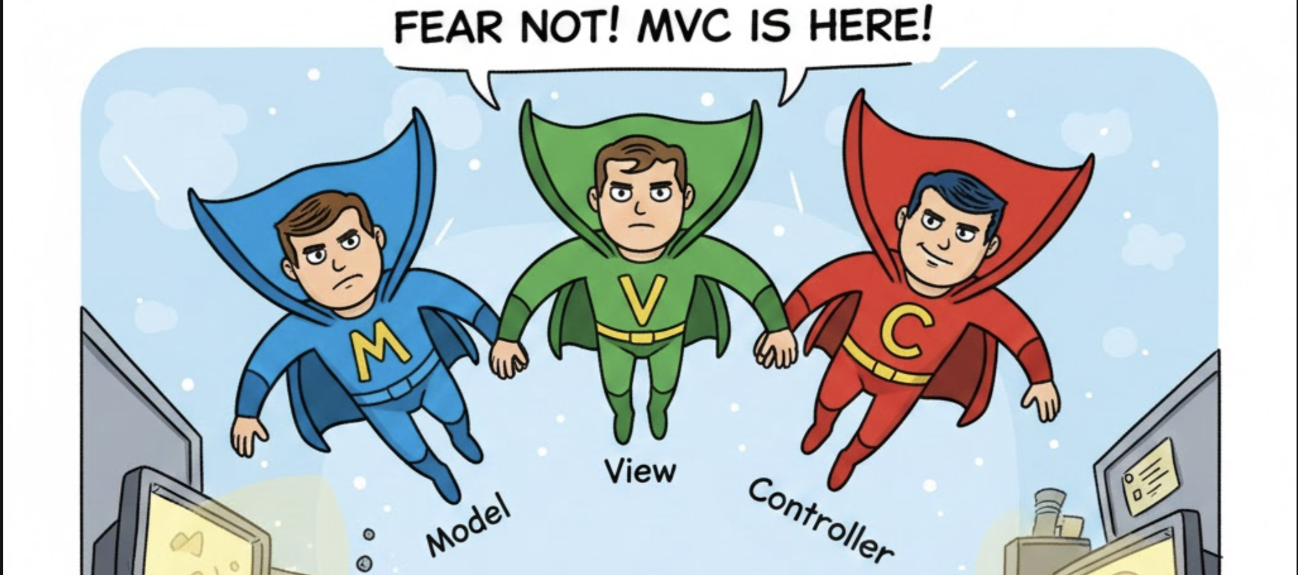
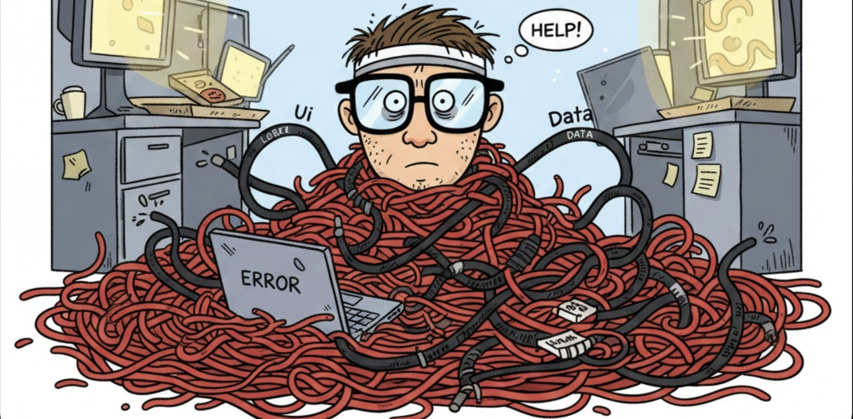

Slide 32
MVC Pattern
The Model–View–Controller pattern provides a structured approach for separating responsibilities in interactive applications.
MVC began as a design-level pattern and evolved into an architectural style across modern development frameworks.
The pattern reduces coupling between data management, presentation, and user interaction logic.
Clear separation of concerns improves testability and maintainability when applications grow in complexity.
MVC scales effectively across web, desktop, and mobile environments.

Slide 33
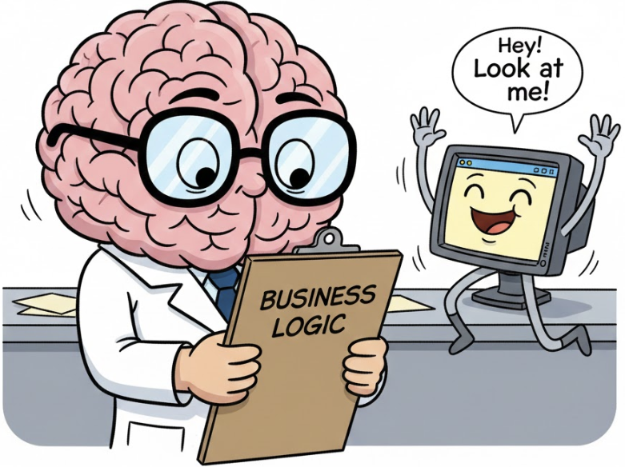
Model
The Model manages application data, business rules, and domain-specific operations.
It remains independent of both View and Controller to enforce clean separation of concerns.
The Model encapsulates validation, state changes, and domain logic without referencing UI elements.
Change notifications allow other components to react when important Model updates occur.

Slide 34
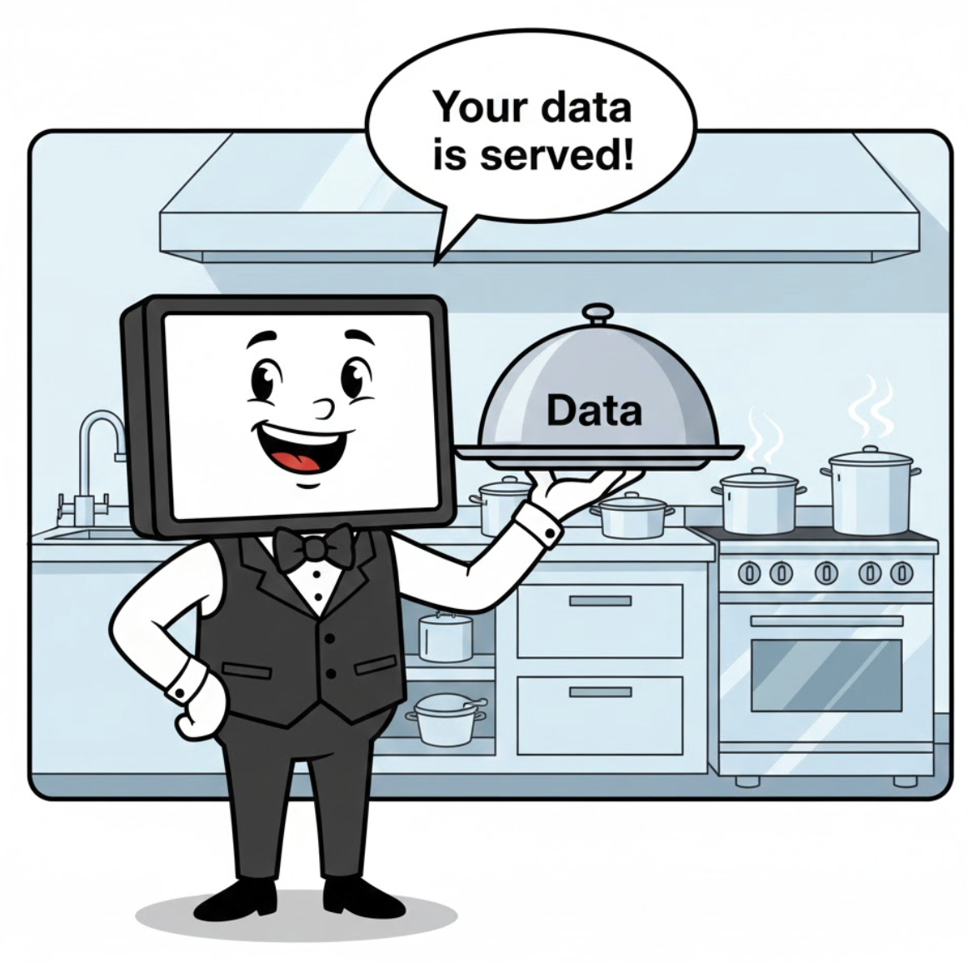
View
The View presents information visually or textually for user consumption.
It focuses on rendering data provided by the Model without embedding business logic.
Multiple Views may represent the same Model, enabling flexible UI customization.
Views update automatically to reflect the current state of the Model.

Slide 35
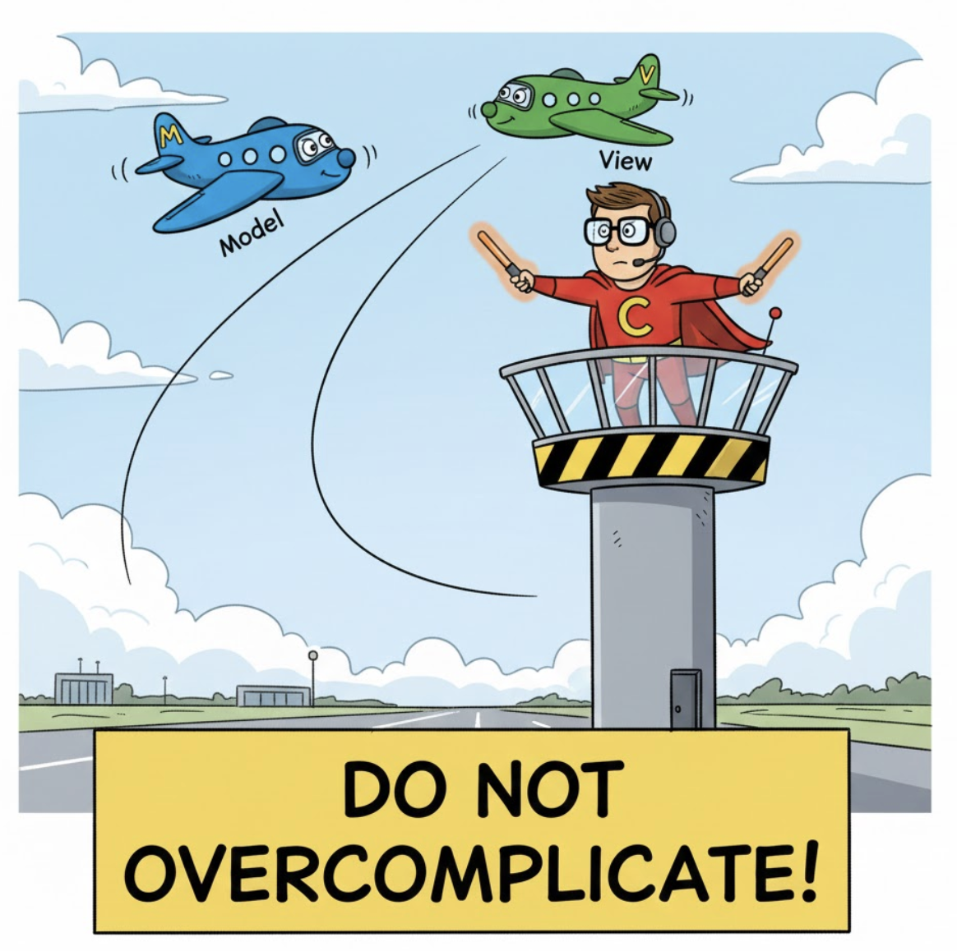
Controller
The Controller interprets user actions and converts them into operations performed on the Model.
It selects which View to present and manages when UI content should refresh.
Controllers handle request processing, input validation, and navigation logic in many frameworks.
Concise Controller design prevents overly complex orchestration and improves maintainability.

Slide 36
MVC Data Flow
User input flows into the Controller, which updates the Model and selects an appropriate View.
The View retrieves Model data and renders it without modifying the Model directly.
The Model issues change notifications, allowing Views to display updates immediately.
A structured data flow reduces ambiguity and supports reliable debugging and maintenance.
MVC is not one of the 23 Gang of Four patterns but incorporates several GoF concepts within its structure.

Slide 37
Thank You☺

